Slide 1
Supermarket Gross Income Analysis
Isaiah Dyer
3/17/2026

Slide 2
introduction
This analysis examines which products, stores, and customer groups generate the most revenue to help optimize sales strategy
Sales data for this analysis was from 1/1/2019 to 3/9/2019
This dataset goes over 1,001 transactions across three different branches

Slide 3
Main questions
What are the most profitable products and what are the most profitable
What customer group generates the most income
What Branch has generated the most income

Slide 4
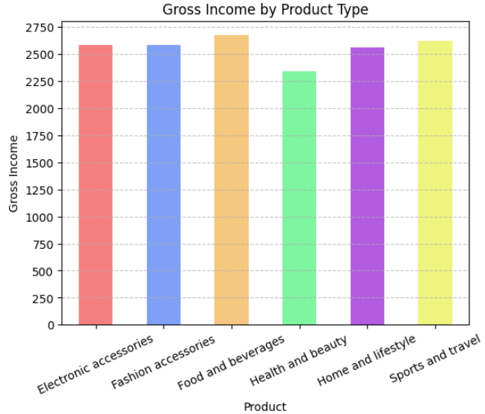
Most profitable products
Food and beverages has the highest gross income followed by sports and travel
Health and beauty has the lowest gross income

Slide 5
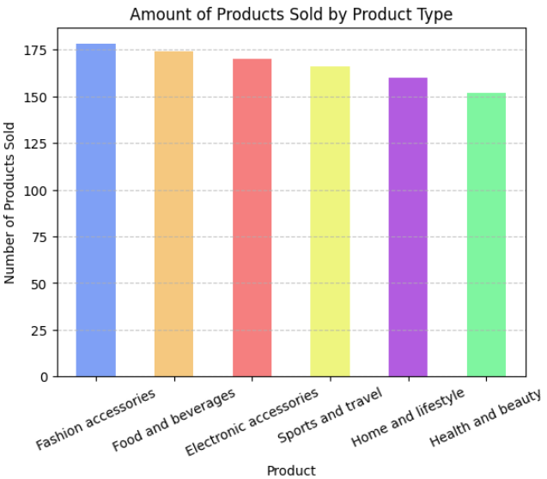
Popularity by products
Fashion accessories has sold the most products with food and beverages close behind
Health and beauty has sold the least amount of products

Slide 6
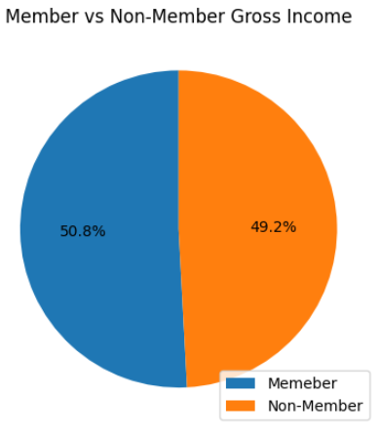
Do members or non-members generate the most revenue
Members generate more income than non-members

Slide 7
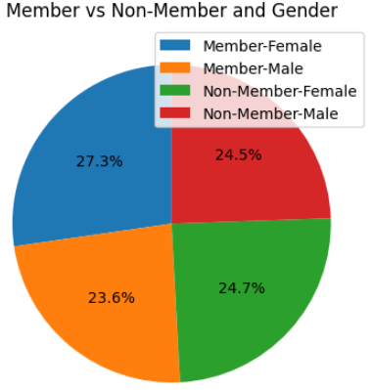
Which customer type brings in the most income
Female members account for the most gross incomes with 27.3%
Females bring in more gross income than males with 52%
Male members bring in the least amount of gross income with only 23.6%

Slide 8
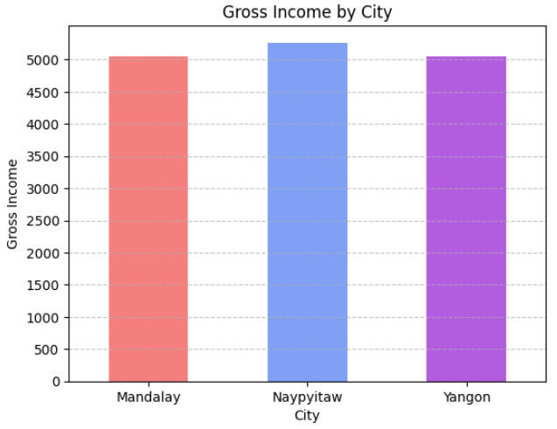
Which branch draws in the highest gross income
Naypyitaw branch has the highest gross income
The Yangon and Mandalay Branch have very similar gross incomes

Slide 9
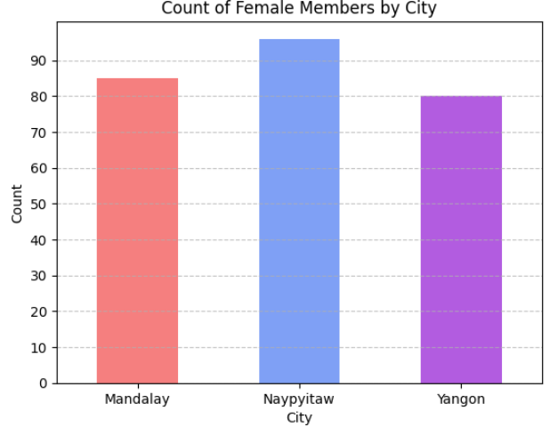
Why does Naypyitaw have the highest gross income
Naypyitaw has the highest number of female members
Female members could correlate with having higher gross incomes

Slide 10
Conclusion
Food and beverages bring in the highest gross income while fashion and beauty are the most popular
Female members contribute the most to income
Naypyitaw branch generates the most which could be caused by them having the most female members

Slide 11
What next?
Prioritize marketing and inventory strategies for Food and Beverages, as well as Fashion and Beauty products, to maximize revenue
Increasing marketing of memberships, with targeted campaigns toward female customers to drive higher revenue

